Slide 1
Lecture 2 – Collection Data Types, NumPy & Pandas
AY 2025-26

Slide 2
On completion of the module, students are expected to be able to:
Module Intended Learning Outcomes
Explain the basic principles of artificial intelligence technologies;
Evaluate and select appropriate machine learning technologies; and
Design and prototype AI/machine learning applications to solve real-life problems.

Slide 3
Module Plan
AI: An Overview & Python Basics
Collection Data Types, NumPy & Pandas
AI Search Techniques
Logic Programming & CSP
Probabilistic Reasoning
ML – Classification
ML – Regression & Clustering
Computer Vision & AI Cloud Services
Natural Language Processing
Recommender Systems
DL – Basic ANN
DL – CNN & RNN

Slide 4
Lesson Outline
L2 – Collection Data Types & NumPy
Collection Data Types
Numerical Python – NumPy
"Panel Data", and "Python Data Analysis" – Pandas

Slide 5
1. Collection Data Types
There are four collection data types in the Python programming language:
List is a collection which is ordered and changeable.
Tuple is a collection which is ordered and unchangeable.
Set is a collection which is unordered and unindexed.
Dictionary is a collection which is ordered and changeable.

Slide 6
List
List Items
List items are ordered and changeable.
List items are indexed, the first item has index [0], second item has index [1] and last item can use index[-1] to represent.
The list is changeable, meaning that we can change, add, and remove items in a list after it has been created.

Slide 7
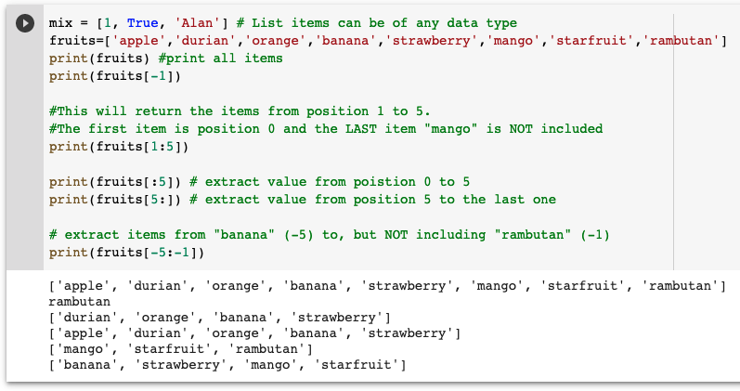
List – Access List items

Slide 8
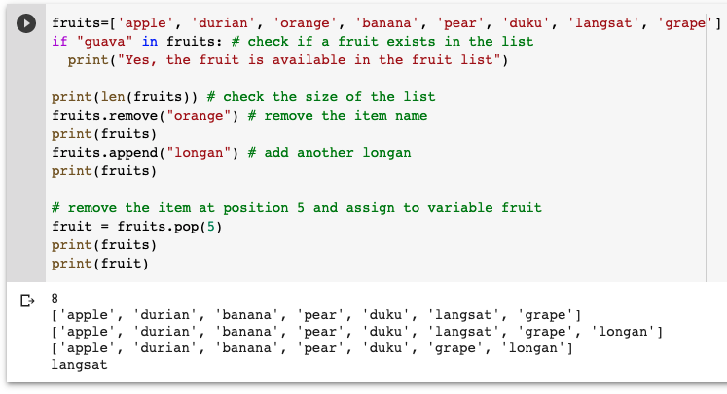
List – add and remove List items

Slide 9
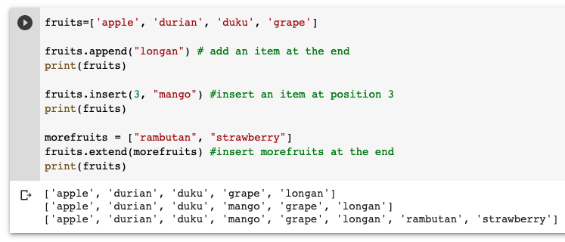
List – Insert List items

Slide 10
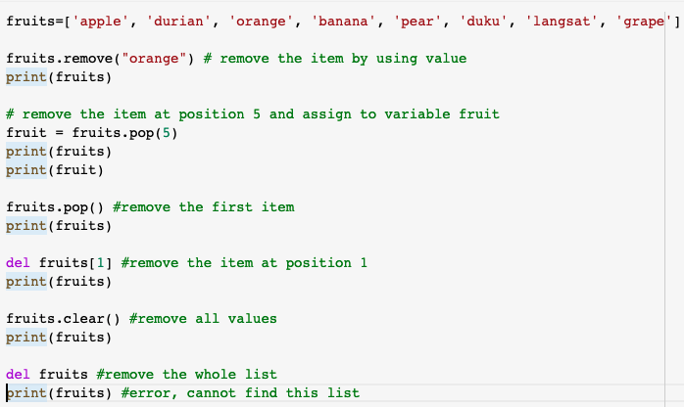
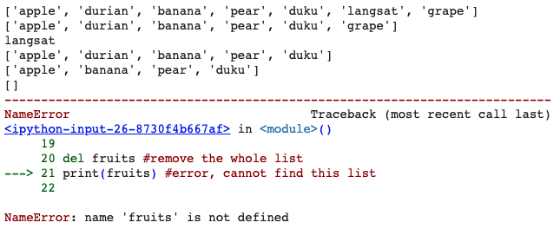
List – Remove List items

Slide 11
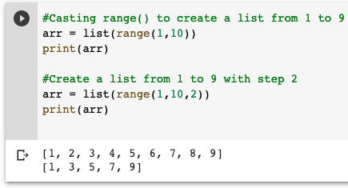
List – Create List by range()
You can use range() function to create a list by casting.

Slide 12
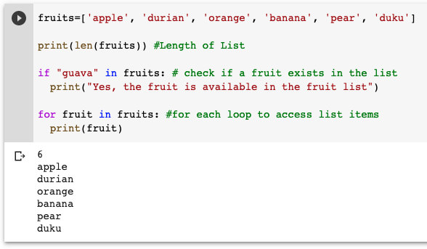
List – More about List items

Slide 13
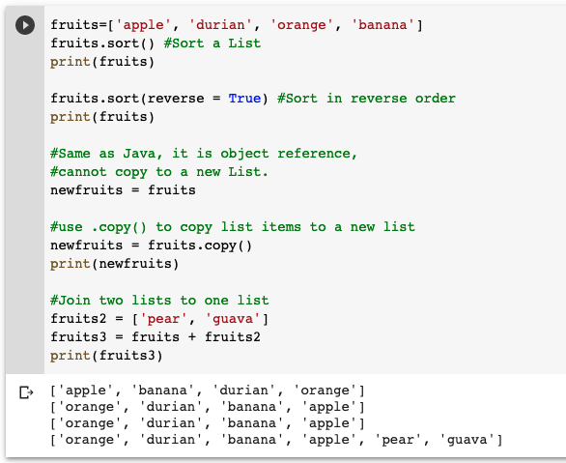
List – More about List items

Slide 14
List Comprehensions
List comprehensions allow us to build out lists using a different notation.
You can think of it as essentially a one line for loop built inside of brackets.
For some simple examples:
>>> lst = [x for x in 'word']
>>> lst
['w', 'o', 'r', 'd']
>>> lst = [s**2 for s in range(10)]
>>> lst
[0, 1, 4, 9, 16, 25, 36, 49, 64, 81]

Slide 15
List Comprehensions (2)
Some more examples:
lst = [n for n in range(11) if n % 2 == 1]
lst
[1, 3, 5, 7, 9]
lst = [ n**2 for n in [n**2 for n in range(5)]]
lst
[0, 1, 16, 81, 256]
[0, 1, 4, 9, 16]

Slide 16
Tuple
Tuple items
Tuples are used to store multiple items in a single variable.
A tuple is a collection which is ordered and UNCHANGEABLE.
Tuples are written with round brackets.

Slide 17
Tuple – Access Tuple items
Access tuple items methods are same as List.

Slide 18
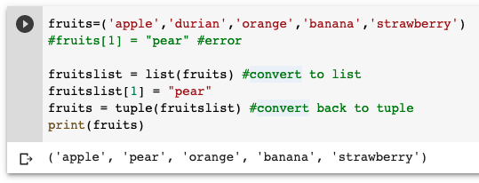
Tuple – Update Tuple items
A tuple is a collection which is ordered and UNCHANGEABLE.
To update Tuple, we need to convert it to List first.
After updated, convert list back to tuple.

Slide 19
2. Numerical Python - NumPy
Python does not support built-in function for arrays.
It also support some mathematic library such as linear algebra, fourier transform, and matrices.
The speed of NumPy is faster than Python lists.
Arrays are frequently used in machine learning, so that speed is very important.

Slide 20
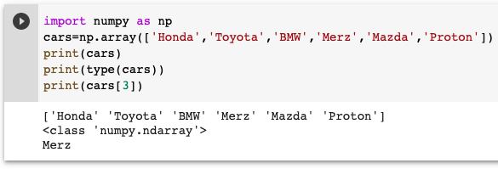
NumPy – Create an array
You need to install NumPy library for your local tools.
import the Numpy lib.
Use numpy method to create an arrays (originally it is a list)

Slide 21
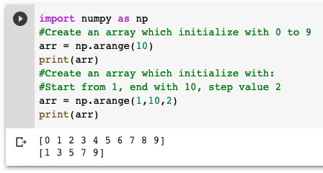
NumPy – Create an array
You can use a numpy method arange(start, stop, step) to create an array.

Slide 22
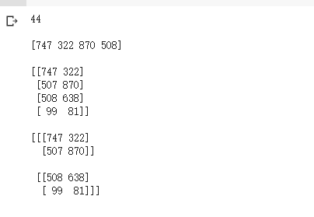
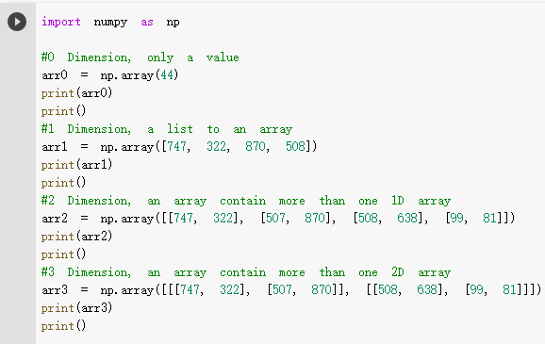
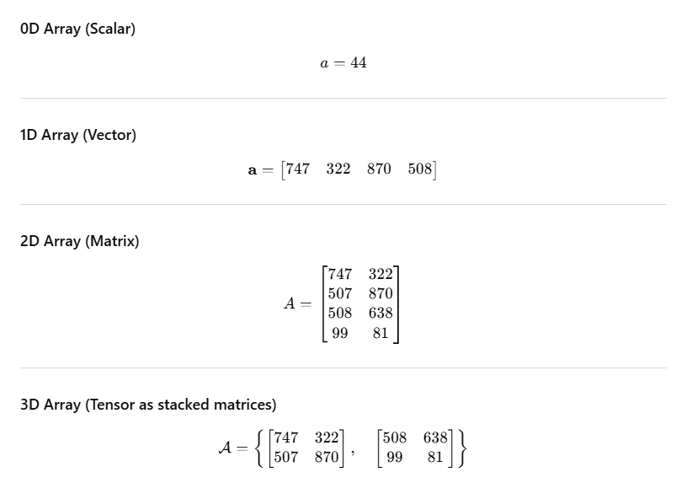
NumPy – Dimensions

Slide 23
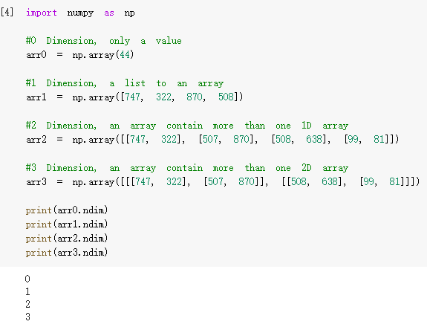
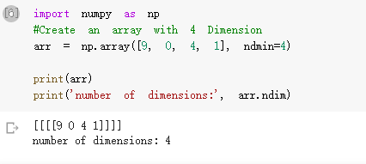
NumPy – Dimensions

Slide 24
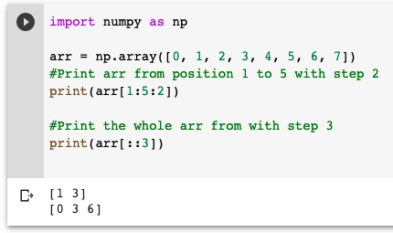
NumPy – Slicing 1-D Arrays

Slide 25
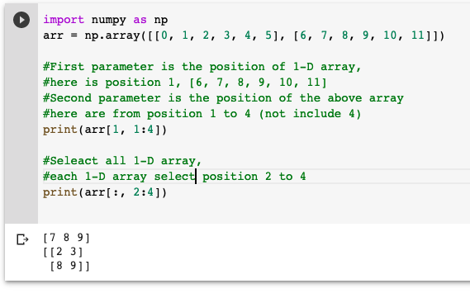
NumPy – Slicing 2-D Arrays

Slide 26
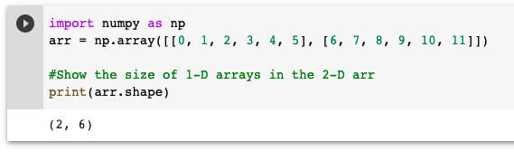
NumPy – Shape of an array
Shape is an attribute of an array which returns a tuple with each index having the number of corresponding elements in an array.

Slide 27
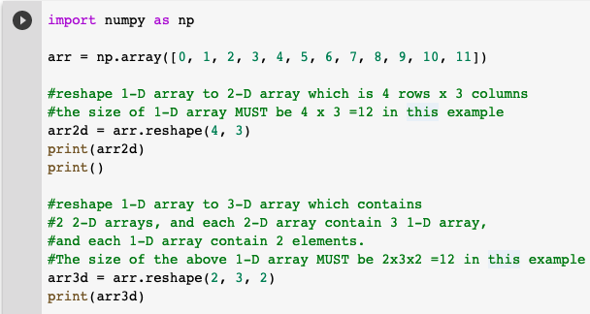
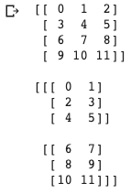
NumPy – Reshape of an array
We can change the dimension of an array by using reshape.

Slide 28
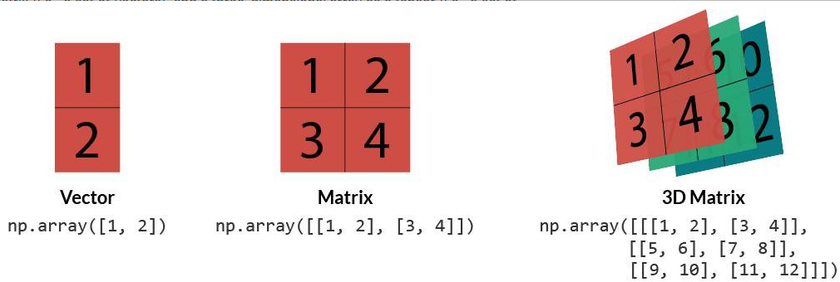
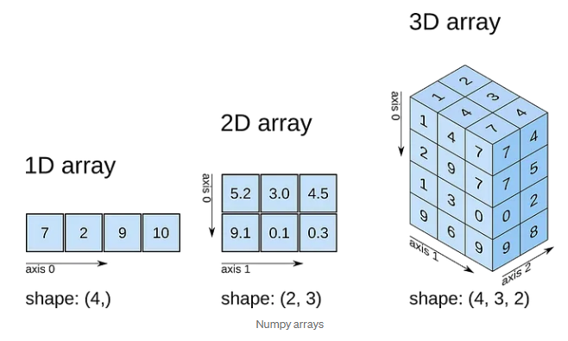
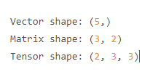
(array, row, col)

Slide 29
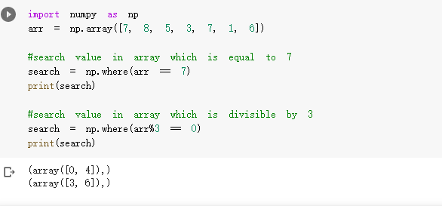
NumPy – Searching an array
You can use where() to search an array for a certain value, and then return a tuple which contains the positions that match condition in where().

Slide 30
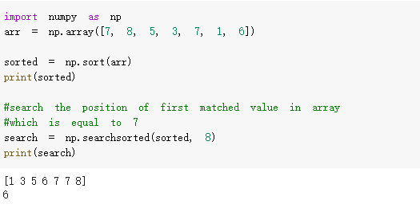
NumPy – Sort and Search an array
You can use sort() to sort an array,
and then use searchsorted() to search that array by using binary search.

Slide 31
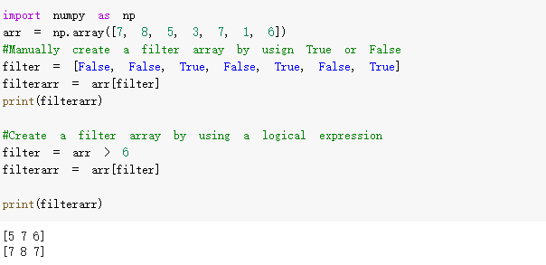
NumPy – Filtering an array
You can use an array which contain True or False to filter another array.

Slide 32
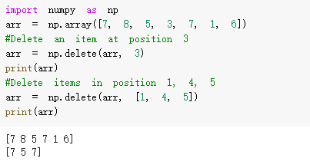
NumPy – Delete items in an array
You can use a numpy method delete(array, index) to delete items in an array.

Slide 33
3. "Panel Data", and "Python Data Analysis" – Pandas
Pandas is a Python package providing fast, flexible, and expressive data structures designed to make working with “relational” or “labeled” data both easy and intuitive.
It aims to be the fundamental high-level building block for doing practical, real world data analysis in Python.
It has the broader goal of becoming the most powerful and flexible open source data analysis / manipulation tool available in any language.

Slide 34
3. "Panel Data", and "Python Data Analysis" - Pandas
The two primary data structures of pandas, Series (1-dimensional) and DataFrame (2-dimensional).
They handle the vast majority of typical use cases in finance, statistics, social science, and many areas of engineering.

Slide 35
Pandas Library
Pandas is a Python package providing fast, flexible, and expressive data structures designed to make working with “relational” or “labeled” data both easy and intuitive.
It aims to be the fundamental high-level building block for doing practical, real world data analysis in Python.
It has the broader goal of becoming the most powerful and flexible open source data analysis / manipulation tool available in any language.

Slide 36
Pandas Library
The two primary data structures of pandas, Series (1-dimensional) and DataFrame (2-dimensional).
They handle the vast majority of typical use cases in finance, statistics, social science, and many areas of engineering.

Slide 37
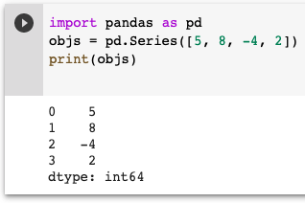
Series
A Series is a one-dimensional array-like object containing:
an array of data, and
an associated array of data labels.

Slide 38
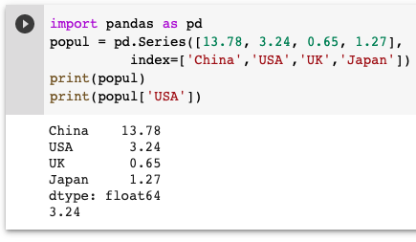
Series
Create a Series with an index:

Slide 39
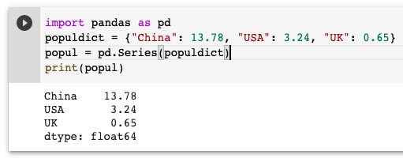
Series
Create a Series with a dictionary :

Slide 40
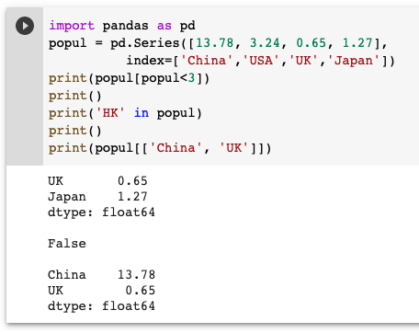
Series
Access Series with indexes :

Slide 41
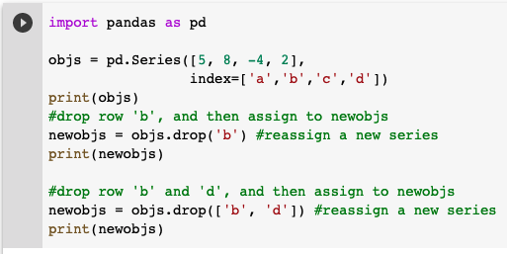
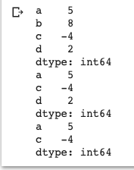
Series - Drop
You can remove rows in Series by using drop:

Slide 42
DataFrame
A DataFrame represents a tabular, spreadsheet-like data structure.
It contains an ordered collection of columns, each of which can be a different value type (numeric, string , boolean, etc.).
It has both a row and column index.
There are numerous ways to construct a DataFrame.
One of the most common is from a dict of equal-length lists or NumPy arrays.

Slide 43
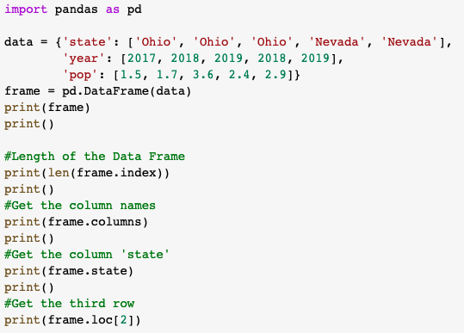
DataFrame

Slide 44
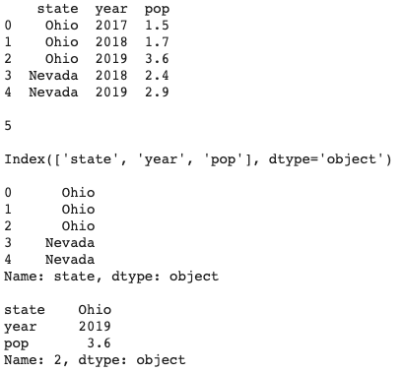
DataFrame

Slide 45
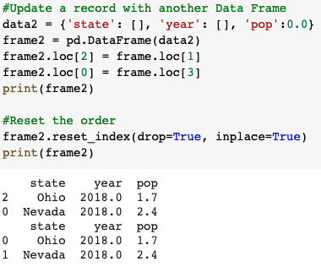
DataFrame - Update

Slide 46
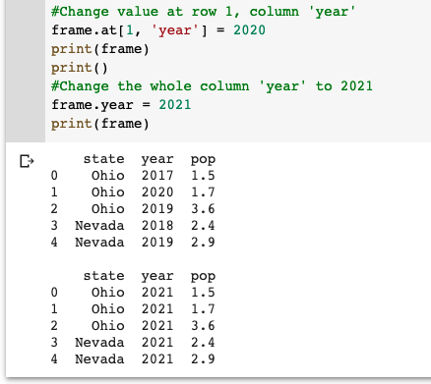
DataFrame - Update

Slide 47
DataFrame - Update

Slide 48
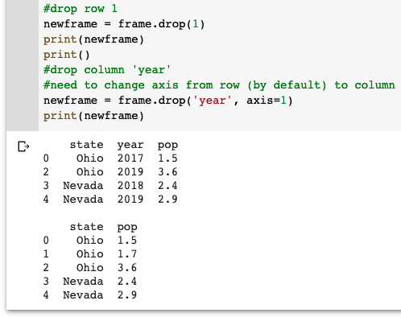
DataFrame - Drop

Slide 49
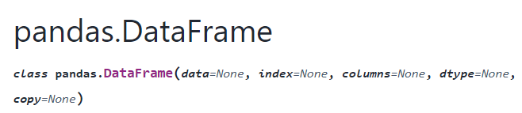
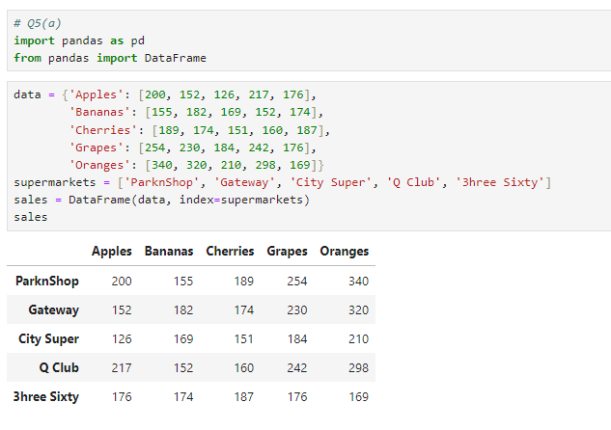
DataFrame

Slide 50


Find the sales of bananas in City Super.
Show the stores' sales figures where Apple sales are greater than 200.
Add a new column called “Total” to the DataFrame to store the total sales

Slide 51

Self Study Guide

Slide 52
Self Study Guide
References
McKinney, W. (2017). Python for Data Analysis (2nd ed.). O’Reilly.
Useful Sites
https://numpy.org/
https://pandas.pydata.org/

